Slide 1
Introduction to Cryptography
Joe McCarthy

Slide 2

Outline
2. Introduction to Cryptography.
  What Is Cryptography?
  Breaking an Encryption Scheme.
  Types of Cryptographic Functions.
  Secret Key Cryptography.
  Public Key Cryptography.
  Hash Algorithms.
Network Security: Private Communication
in a Public World, 2/E
Charlie Kaufman
Radia Perlman
Mike Speciner
CSS 432: Introduction to Cryptography

Slide 3

Cryptography
The art of secret writing.
The art of mangling information into apparent unintelligibility
in a manner allowing a secret method of unmangling.
CSS 432: Introduction to Cryptography

Slide 4
Cryptography Definitions
Messages:
  Plaintext
  Ciphertext
Ingredients:
  Algorithm(s)
  Key(s)
Players:
  Cryptographer: invents clever algorithms
  Cryptanalyst: breaks clever algorithms
CSS 432: Introduction to Cryptography

Slide 5
Cryptography
Algorithm
Key(s) = secret value(s)
OK for good algorithm to be public
  Not OK to use bad algorithm
  “Sunlight is the best disinfectant”
  Algorithm without key does not help unmangle the information
CSS 432: Introduction to Cryptography

Slide 6

Computational Issues
Algorithm should be reasonably efficient
Security depends on how hard it is to break
Combination lock
  3 number sequence (2R, 1L, 0R), #s between 1-40
    Possible combinations:
CSS 432: Introduction to Cryptography

Slide 7
Computational Issues
Algorithm should be reasonably efficient
Security depends on how hard it is to break
Combination lock
  3 number sequence (2R, 1L, 0R), #s between 1-40
    Possible combinations: 40³ = 64,000
    10 seconds per sequence: 178 hours (/ 2 = 89)
CSS 432: Introduction to Cryptography

Slide 8
Computational Issues
Algorithm should be reasonably efficient
Security depends on how hard it is to break
Combination lock
  3 number sequence (2R, 1L, 0R), #s between 1-40
    Possible combinations: 40³ = 64,000
    10 seconds per sequence: 178 hours (/ 2 = 89)
CSS 432: Introduction to Cryptography

Slide 9
Computational Issues
Algorithm should be reasonably efficient
Security depends on how hard it is to break
Combination lock
  3 number sequence (2R, 1L, 0R), #s between 1-40
    Possible combinations: 40³ = 64,000
    10 seconds per sequence: 178 hours (/ 2 = 89)
  4 number sequence, 13 seconds per sequence
CSS 432: Introduction to Cryptography

Slide 10
Computational Issues
Algorithm should be reasonably efficient
Security depends on how hard it is to break
Combination lock
  3 number sequence (2R, 1L, 0R), #s between 1-40
    Possible combinations: 40³ = 64,000
    10 seconds per sequence: 178 hours (/ 2 = 89)
  4 number sequence, 13 seconds per sequence
    40⁴ = 2,560,000
    9,244 hours
CSS 432: Introduction to Cryptography

Slide 11

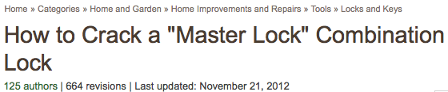
Computational Issues
Algorithm should be reasonably efficient
Security depends on how hard it is to break
Combination lock
  3 number sequence (2R, 1L, 0R), #s between 1-40
    Possible combinations: 40³ = 64,000
    10 seconds per sequence: 178 hours (/ 2 = 89)
  4 number sequence, 13 seconds per sequence
    40⁴ = 2,560,000
    9,244 hours
CSS 432: Introduction to Cryptography

Slide 12
Publication Issues
Public or secret algorithms?
CSS 432: Introduction to Cryptography

Slide 13
Publication Issues
Public or secret algorithms:
  OK for good algorithm to be public
  “Sunlight is the best disinfectant”
  Reverse engineering, leaks
  “Free consulting” by cryptanalysts
Generally:
  Commercial: public
  Military: secret
CSS 432: Introduction to Cryptography

Slide 14
Secret Codes
Caesar cipher
  Substitute letter 3 letters further on
    DOZEN → GRCHQ
CSS 432: Introduction to Cryptography

Slide 15

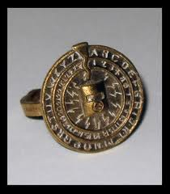
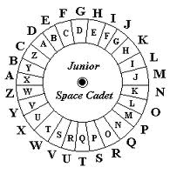
Secret Codes
Caesar cipher
  Substitute letter 3 letters further on
    DOZEN → GRCHQ
Captain Midnight Secret Decoder Rings
  Substitute letter n letters further on (n = 1..25)
    HAL → IBM (n = 1)
CSS 432: Introduction to Cryptography

Slide 16
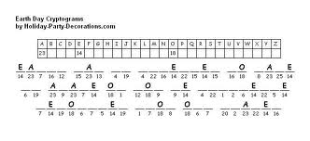
Secret Codes
Caesar cipher
  Substitute letter 3 letters further on
    DOZEN → GRCHQ
Captain Midnight Secret Decoder Rings
  Substitute letter n letters further on (n = 1..25)
    HAL → IBM (n = 1)
Monoalphabetic cipher
  Arbitrary mappings (26! = 4.03291461 × 10²⁶)
    1 ms / try → 10M years … but: letter frequencies
CSS 432: Introduction to Cryptography

Slide 17
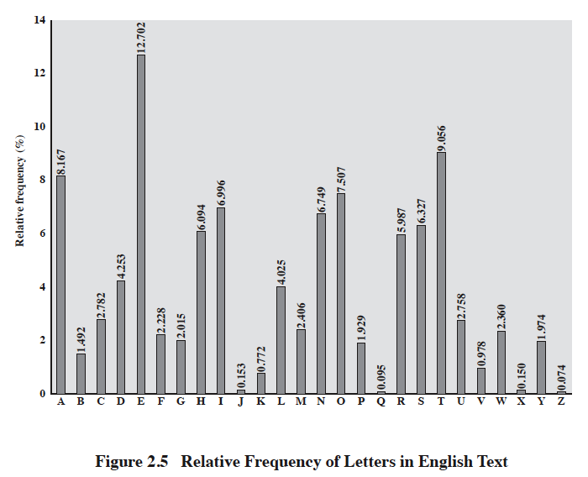
[from Stallings, Cryptography & Network Security]
CSS 432: Introduction to Cryptography

Slide 18
Breaking an Encryption Scheme
Ciphertext only
  Try all possible keys, look for intelligibility
  Need sufficiently long ciphertext
  XYZ = ?
Known plaintext
  (plaintext, ciphertext) pair(s)
Chosen plaintext
  Have plaintext encrypted, compare expected values
CSS 432: Introduction to Cryptography

Slide 19
Types of Cryptography
Public Key
  Two keys: public & private
Symmetric Key (aka “Secret Key”)
  One key: secret (but possibly shared)
Hash Functions
  No keys
CSS 432: Introduction to Cryptography

Slide 20
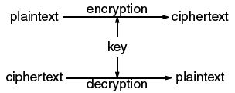
Symmetric Key Cryptography
AKA secret key cryptography
AKA conventional cryptography
CSS 432: Introduction to Cryptography

Slide 21
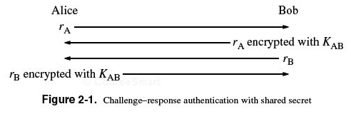
Symmetric Key Applications
Transmission over insecure channel
  Shared secret (transmitter, receiver)
Secure storage on insecure media
Authentication
  Strong authentication: prove knowledge
  without revealing key
CSS 432: Introduction to Cryptography

Slide 22
A simple example
K_{AB} = +3 (Caesar cipher), known by Alice & Bob
r_{A} = “marco”
  r_{A} encrypted with K_{AB}:
r_{B} = “polo”
  r_{A} encrypted with K_{AB}:
CSS 432: Introduction to Cryptography

Slide 23
A simple example
K_{AB} = +3 (Caesar cipher), known by Alice & Bob
r_{A} = “marco”
  r_{A} encrypted with K_{AB}: “pdufr”
r_{B} = “polo”
  r_{A} encrypted with K_{AB}: “sror”
CSS 432: Introduction to Cryptography

Slide 24
A simple example
K_{AB} = +3 (Caesar cipher), known by Alice & Bob
r_{A} = “marco”
  r_{A} encrypted with K_{AB}: “pdufr”
r_{B} = “polo”
  r_{A} encrypted with K_{AB}: “sror”
(“marco”, “pdufr”), (“polo”, “sror”)
CSS 432: Introduction to Cryptography

Slide 25
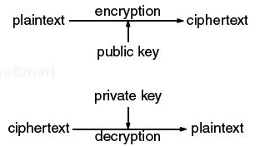
Public Key Cryptography
AKA asymmetric cryptography
AKA unconventional cryptography (?)
Public key: published, ideally known widely
Private key (NOT “secret key”): not published
CSS 432: Introduction to Cryptography

Slide 26
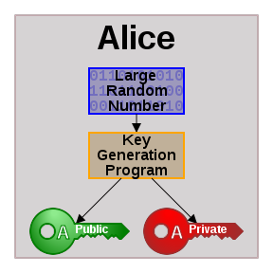
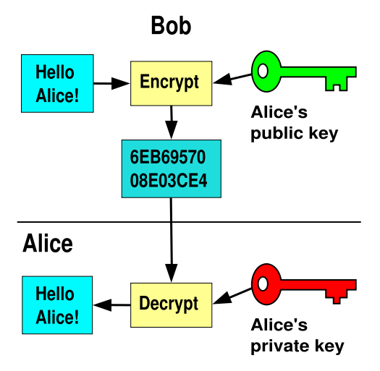
Public Key Cryptography
http://en.wikipedia.org/wiki/Public_key_cryptography
CSS 432: Introduction to Cryptography

Slide 27
Public Key Cryptography Issues
Efficiency
  Public key cryptographic algorithms are orders of magnitude slower than symmetric key algorithms
Hybrid model
  Public key used to establish temporary shared key
  Symmetric key used for remainder of communication
CSS 432: Introduction to Cryptography

Slide 28
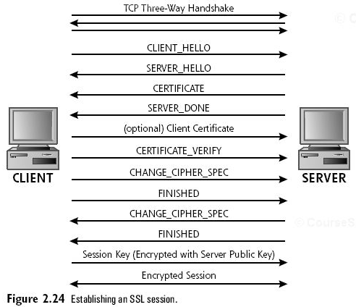

SSL / TLS
CLIENT_HELLO:
  Available crypto & compression algorithms
  Highest SSL/TLS protocol version
  SSL Session ID
  Random data
SERVER_HELLO
  Specific crypto & compression
  Specific SSL version
  SSL Session ID
  Random data
CERTIFICATE
  Server’s public encryption key
Session Key
  Server’s public encryption key + random data
CSS 432: Introduction to Cryptography

Slide 29
Secure Storage on Insecure Media
Option 1:
  Encrypt with public key
  Decrypt with private key
CSS 432: Introduction to Cryptography

Slide 30
Secure Storage on Insecure Media
Option 1:
  Encrypt with public key
  Decrypt with private key
Option 2:
  Generate random secret key
  Encrypt with that secret key
  Encrypt secret key with public key
CSS 432: Introduction to Cryptography

Slide 31
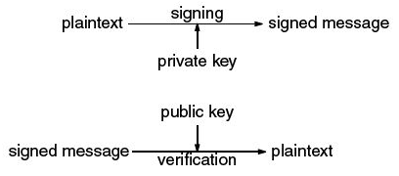
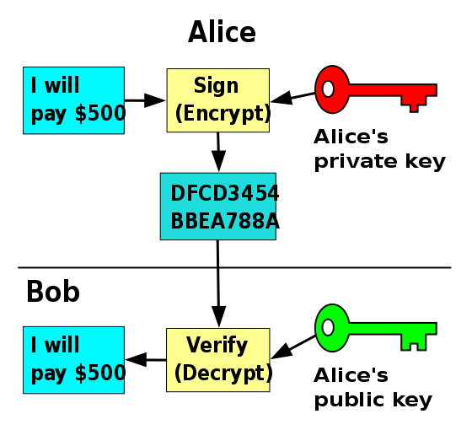
Digital Signatures
Asymmetry:
Signature can only be generated by owner/knower of private key
Signature can be verified by anyone via public key
Non-repudiation:
Sender cannot prove message (signature) was not sent
Key may have been stolen
CSS 432: Introduction to Cryptography

Slide 32
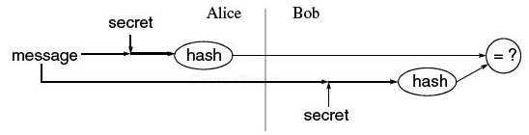
Message Integrity
Keyed hash, shared secret
CSS 432: Introduction to Cryptography

Slide 33
Hash Algorithms
Message digests / one-way transformations
  easy to compute a hash value for any given message
  infeasible to find a message that has a given hash
  infeasible to modify a message without hash being changed
  infeasible to find two different messages with the same hash
http://en.wikipedia.org/wiki/Cryptographic_hash_function
CSS 432: Introduction to Cryptography

Slide 34
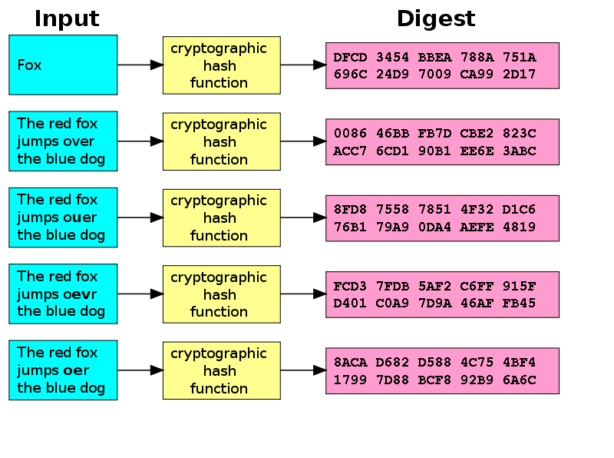
Hash Algorithms
http://en.wikipedia.org/wiki/Cryptographic_hash_function
CSS 432: Introduction to Cryptography

Slide 35
An example
This example uses the common unix utility "md5sum", which hashes the data on stdin to a 128 bit hash, displayed as 32 hex digits.
Assume the password is "mysecretpass" and both the client and the server know this.
The client connects to the server.
The server makes up some random data, say "sldkfjdslfkjweifj”.
The server sends this data to client.
The client concatenates the random data with the password, resulting in
"sldkfjdslfkjweifjmysecretpass"
The client computes the MD5 hash of this value:
$ echo sldkfjdslfkjweifjmysecretpass | md5sum
4fab7ebffd7ef35d88494edb647bac37
The client sends "4fab7ebffd7ef35d88494edb647bac37" to the server.
[The server confirms that it gets the same value when it runs echo "sldkfjdslfkjweifjmysecretpass” | md5sum]
http://www.hcsw.org/reading/chalresp.txt
CSS 432: Introduction to Cryptography

Slide 36
md5sum on Linux
[joemcc@uw1-320-17 ~]$ cat > test1.txt
Testing 1, 2, 3
[joemcc@uw1-320-17 ~]$ md5sum test1.txt
6a8c5c1973dd8ed2df1260297964cd64 test1.txt
[joemcc@uw1-320-17 ~]$ cp test1.txt test2.txt
[joemcc@uw1-320-17 ~]$ md5sum test2.txt
6a8c5c1973dd8ed2df1260297964cd64 test2.txt
[joemcc@uw1-320-17 ~]$ cat > test3.txt
Testing 1, 2, 4
[joemcc@uw1-320-17 ~]$ md5sum test3.txt
5e361a608a1f63b154f259dba0f452dc test3.txt
[joemcc@uw1-320-17 ~]$ echo "Testing 1, 2, 3" | md5sum
6a8c5c1973dd8ed2df1260297964cd64 -
[joemcc@uw1-320-17 ~]$
CSS 432: Introduction to Cryptography

Slide 37
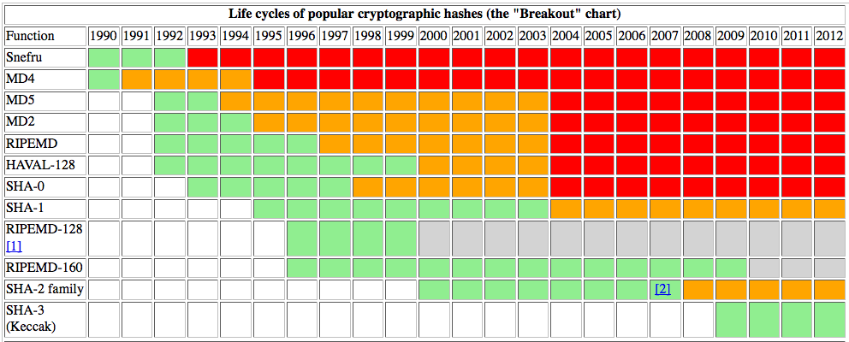
Cryptographic Hash Lifecycle
http://valerieaurora.org/hash.html
[via http://www.schneier.com/blog/archives/2011/06/the_life_cycle.html]
CSS 432: Introduction to Cryptography

Slide 38
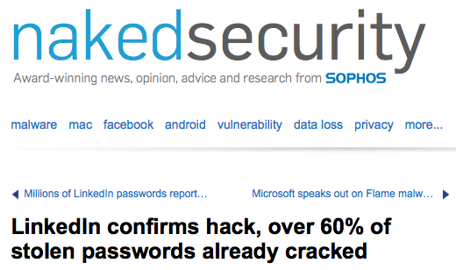
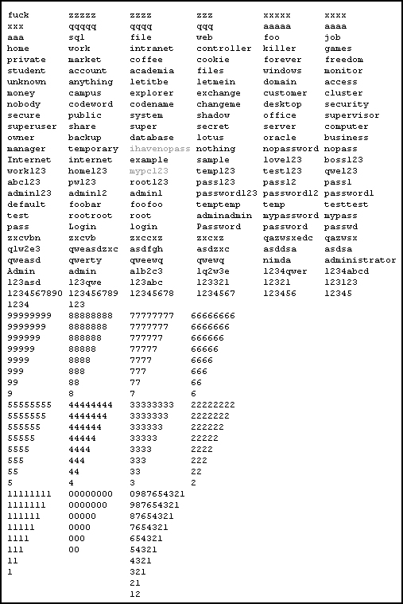
Password Hashing
Only hashes (not passwords) are stored
Passwords can still be guessed (dictionary)
http://nakedsecurity.sophos.com/2012/06/06/linkedin-confirms-hack-over-60-of-stolen-passwords-already-cracked/
CSS 432: Introduction to Cryptography

Slide 39
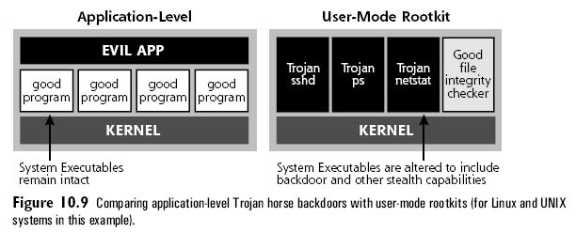
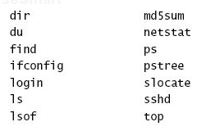
Message Fingerprint
Compute h(message)_{t1}
Compare to h(message)_{t2}
Message can be a program (e.g., ssh)
shv4
CSS 432: Introduction to Cryptography

